Slide 1

Company Law (LC2008C) 9. Corporate organs and decision-making
LC2008C
Kenneth Khoo
kenneth.khoo@nus.edu.sg

Slide 2

Corporate constitution and membership
Introduction and Theoretical Background
Division of Powers between the Organs
General Principles
Reserve Powers of the Members

Slide 3
Corporate constitution and membership
The Mechanisms of Organ Decision-Making
Meetings
Written Resolutions
Unanimous Assent
Procedural Irregularities

Slide 4
Introduction and theoretical background
Recall Slide Decks 8 and 9. In that topic (Corporate Constitution and Membership), we focused on the legal relationship between the “insiders” of the Company, particularly in relation to shareholders.
In this topic (Corporate Organs and Decision-Making), we will focus on the legal relationships between the shareholders and the directors, the two organs of the company.
Also recall Slide Deck 6 (Corporate Acts and Liabilities I: Slide 4).
There, we discussed the notion that a company is an artificial entity that can only act through natural persons.
Thus, the question arose as to what acts may be regarded as acts of the company.
As you might recollect, the rules that identify those acts which may be regarded as the acts of the company as known as the rules of attribution.

Slide 5
Introduction and theoretical background
In this topic (Corporate Organs and Decision-Making), we will focus on the legal relationships between the shareholders and the directors, the two organs of the company.
In the seminal case of Meridian Global Funds Management Asia Ltd v Securities Commission [1995] 2 AC 500, Lord Hoffmann identified three categories of attribution rules.
Primary rules of attribution found in the company’s constitution or the Company’s Act
General rules of attribution (rules of agency and vicarious liability)
Special rules of attribution (rules of attribution in particular statutes)
In the topic “Corporate Acts and Liabilities”, we focused on (2), in particular on the rules of agency.
Here, we will focus on (1) – the primary rules of attribution. The primary rules of attribution relate to the attribution of the acts of the company’s organs to the company.

Slide 6
Introduction and theoretical background
Company’s Organs
Board of Directors
Members acting at GM
Insofar as the rules of attribution (in relation to companies) are concerned, the rules of agency regulated how the company’s agents could bind the company (as legal principal) vis-à-vis third parties.
However, all of these agents are contracting on behalf of the company – while they can legally bind the company, they are not the company.
The question is then: Who is the company?
The primary rules of attribution determine that the acts of the decision-making organs are attributable to that of the company itself.
There are two decision-making organs in a given company:
The Board of Directors
The Members acting at General Meeting (and occasionally, elsewhere)

Slide 7
Introduction and theoretical background
Why two organs? Why not one?
Benefits arising from the separation of ownership and control. See Slide Deck 2.
How is decision-making power allocated amongst the two decision-making organs of the company?
Via the (1) Company’s Constitution and (2) The Companies Act.
Recall Slide Decks 8 and 9. In that topic (Corporate Constitution and Membership), we discussed how (1) (i.e. the company’s constitution) was a statutory contract that bound members and the company inter se (s 39(1) CA).
Thus, the primary justification for the existence of rules regulating the company’s constitution stemmed from its contractarian nature.
Facilitating contracting via the provision of default rules
Addressing contracting problems (e.g. the exploitation of the minority shareholders by majority shareholders) that arose in this “special” multilateral contract between “insiders” of the company.
In the previous topic, we examined how the law addressed some of these problems (e.g. by imposing duties at common law on majority shareholders insofar as consti amendments were concerned).

Slide 8
Introduction and theoretical background
Similarly, the allocation of decision-making power in companies today is largely seen as a contractarian problem.
Thus, insofar as the division of powers is concerned, the law (again) seeks to facilitate contracting/address contracting problems by specifying rules as to (1) the types of decisions that each organ is able to make and (2) how they can make them.
Division of Powers: Should “insiders” of the firm get to decide who can make what types of decisions (i.e. should the law prescribe a default rule)? Or should the law prescribe this as a mandatory rule?
Mechanisms of Organ Decision-Making: What happens when there is a procedural defect in the decision-making process? How should the law intervene?

Slide 9
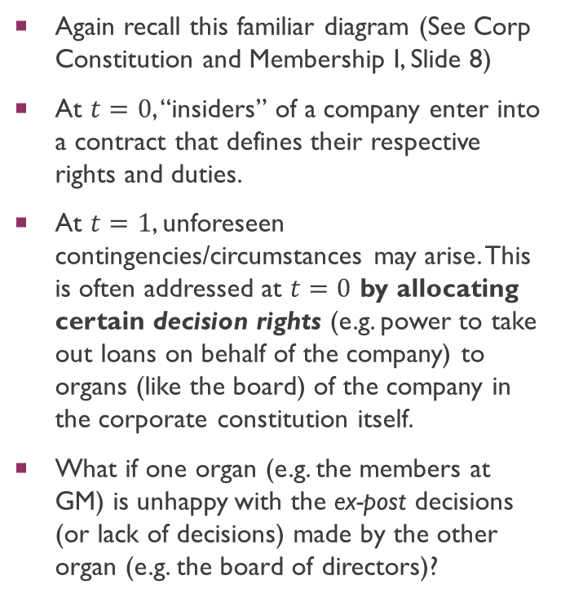
Introduction and theoretical background
Corporate Constitution
Again recall this familiar diagram (See Corp Constitution and Membership I, Slide 8)
At $t=0$, “insiders” of a company enter into a contract that defines their respective rights and duties.
At $t=1$, unforeseen contingencies/circumstances may arise. This is often addressed at $t=0$ by allocating certain decision rights (e.g. power to take out loans on behalf of the company) to organs (like the board) of the company in the corporate constitution itself.
What if one organ (e.g. the members at GM) is unhappy with the ex-post decisions (or lack of decisions) made by the other organ (e.g. the board of directors)?
Ex Post “Gap Filling” via allocation of decision rights
Ex Ante Contract
time
0
1

Slide 10
Introduction and theoretical background
Shareholder-Managerial Agency Costs
Board Power
Shareholder-Shareholder Agency Costs
Shareholder Power
Recall Slide Deck 2. If corporate law allocates relatively more decision-making power to the shareholders, majority shareholders may have stronger incentives to exploit minority shareholders.
C.f. Berle and Means (1932), who thought that vesting power in the shareholders would ameliorate managerial-shareholder agency costs.
In contrast, if corporate law allocates relatively more power to the board of directors, the directors may have stronger incentives to exploit shareholders (as a whole).
C.f. Blair and Stout (1999). Vesting authority/power in the board of directors ameliorates the incentives for shareholders to “use their power of ownership against each other”.
Should the law even play a role in the allocation of power between the two organs? Isn’t this something for the “insiders” of a company to decide?

Slide 11
Introduction and theoretical background
Does a formal separation of powers even make sense for smaller companies, where shareholders and the directors are often the same members?
Shareholders
Managers & Employees
Board of Directors
“The Company”

Slide 12
Division of powers between the organs: general principles
Historically, at common law, the relationship between shareholders and the directors was a hierarchical one.
This meant that the board of directors derived their decision-making power from the shareholders.
Why? Because shareholders were thought of “owners” of the company due to their contribution of capital.
Hence, a director was seen akin to an employee, employed by the “owners” of a firm.
Isle of Wight Railway Co v Tahourdin (1993) 25 Ch D 320: “[it] is a very strong thing indeed to prevent the shareholders from holding a meeting of the company, when such a meeting is the only way in which they can interfere, if the majority of them think that the course taken by the directors, in a matter intra vires the directors, is not for the benefit of the company”.

Slide 13
Division of powers between the organs: general principles
More recently, however, the legal position at common law considers both the general meeting and the board of directors as respectively deriving directly from the company’s constitution, original authority to commit the company to juristic acts.
Thus, the relative power of the shareholders (acting at general meetings) vis-à-vis the directors depends on the particular terms of the constitution.
As a general rule, neither organ is permitted to usurp the authority that has been constitutionally conferred on the other organ.
As an aside, if the shareholders typically have the right to appoint directors (see s 149B CA) and remove them (see s 152 CA), why would shareholders voluntarily vest constitutional power in directors?
Benefits from separation of ownership and control + the credible delegation of authority to managers (see Easterbrook and Fischel (1999))

Slide 14
Division of powers between the organs: general principles
John Shaw & Sons (Salford) Ltd v Shaw [1935] 2 KB 113
“A company is an entity distinct alike from its shareholders and its directors. Some of its powers may, according to its articles, be exercised by directors, certain other powers may be reserved for the shareholders in general meeting. If powers of management are vested in the directors, they and they alone can exercise these powers ... They cannot themselves usurp the powers which by the articles are vested in the directors any more than the directors can usurp the powers vested by the articles in the general body of shareholders.”

Slide 15
Division of powers between the organs: general principles
Note: Even if we adopt the common law position that the appropriate separation/division of powers between the organs of the company is largely left as a matter of private contracting for the company’s incorporators to decide, certain issues are required by the Companies Act to be resolved by the general meeting.
Use of mandatory rules as compared to default rules (see Slide Deck 2, Slide 28).
Examples (many others like 160, 163, 168(1), etc. provided in next topic):
s 71 CA (alteration of capital)
s 76B to 76G (acquisition of company’s own shares)
s 161 (issuance of company shares)
Why? Contracting problems: In particular, large director-shareholder agency costs with regard to such issues.
If directors were given the power to issue shares on behalf of the company, for instance, they could dilute the rights of existing shareholders. In corporate finance, this is known as equity dilution.

Slide 16
Division of powers between the organs: general principles
The common law (UK) position as stated in John Shaw & Sons (Salford) Ltd v Shaw [1935] 2 KB 113 is further illuminated by the cases of Automatic Self-Cleaning Filter Syndicate Co v Cunninghame [1906] 2 Ch 34 and Breckland Group v London and Suffolk [1989] BCLC 100.
As mentioned earlier, these cases suggest that neither organ is permitted to usurp the authority that has been constitutionally conferred on the other organ.
We will contrast this with the Singapore position later.

Slide 17
Division of powers between the organs: general principles
Automatic Self-Cleansing Filter Syndicate Co Ltd v Cuninghame [1906] Ch 34
Facts: A company's constitution vested general management powers of the company in the board of directors (Art 96). In particular, one provision in the constitution specifically empowered the board of directors to “sell … any property … to which the company may be entitled, on such terms and conditions as they see fit” (Art 91). A majority of the shareholders (55%) voted to sell the company's property to another company. As the directors were against this course of action, they declined to comply with the shareholders' resolution. The plaintiff, a shareholder, brought an action in the name of the company [NB: we will learn about these actions in a subsequent topic] against the directors .

Slide 18
Division of powers between the organs: general principles
Automatic Self-Cleansing Filter Syndicate Co Ltd v Cuninghame [1906] Ch 34
Held: The board of directors was entitled to refuse to comply with the shareholders' resolution pursuant to the provisions in the constitution.
“[T]he directors have absolute power to do all things other than those that are expressly required to be done by the company; and then comes the limitation on their general authority — ‘subject to such regulations as may from time to time be made by extraordinary resolution’. Therefore, if it is desired to alter the powers of the directors that must be done, not by a resolution carried by a majority at an ordinary meeting of the company, but by an extraordinary resolution. In these circumstances it seems to me that it is not competent for the majority of the shareholders at an ordinary meeting to affect or alter the mandate originally given to the directors, by the articles of association.”
See also similar conclusion in Breckland Group v London and Suffolk [1989] BCLC 100

Slide 19
Division of powers between the organs: general principles
In Singapore, the current legal position ought to be understood in light of its historical context/backdrop.
Prior to the introduction of s 157A of the Companies Act, the relevant provision was found in the then operative model constitution, Article 73 of Table A of the Fourth Schedule to the Companies Act (Cap 50, 1994 Rev Ed).
Art 73 provided the following:
“The business of the company shall be managed by the directors who may pay all expenses incurred in promoting and registering the company, and may exercise all such powers of the company as are not, by the Act or by these Regulations, required to be exercised by the company in general meeting, subject, nevertheless, to any of these Regulations, to the provisions of the Act, and to such regulations, being not inconsistent with the aforesaid Regulations or provisions, as may be prescribed by the company in general meeting; but no regulation made by the company in general meeting shall invalidate any prior act of the directors which would have been valid if that regulation had not been made.”

Slide 20
Division of powers between the organs: general principles
Credit Development Pte Ltd v IMO Pte Ltd [1993] 1 SLR(R) 68
Facts: The plaintiff, a private company, sought the guidance of the court to answer whether the company was bound to table some of the shareholder resolutions sought by the defendants, who were minority shareholders of the plaintiff. In general, the defendants were unsatisfied with the plaintiff's directors for engaging in several questionable (potentially self-dealing/related 3P) transactions. The defendant thus sought to include several resolutions in the next general meeting, including, inter alia, the appointment of accountants and solicitors to investigate the transactions made by the directors. The company declined on the ground that the matters in the resolutions came within the purview of the directors and a general meeting was not the proper forum to deliberate them. Importantly, the plaintiff had incorporated Art 73 [see aforementioned slide] in its constitution.

Slide 21
Division of powers between the organs: general principles
Credit Development Pte Ltd v IMO Pte Ltd [1993] 1 SLR(R) 68
Held: The qualifying words “subject, nevertheless, to any of these Regulations, to the provisions of the Act, and to such regulations, being not inconsistent with the aforesaid Regulations or provisions, as may be prescribed by the company in general meeting” meant that the shareholders in general meeting retained the overriding power to supersede the directors’ exercise of their powers.
At [22]: “These words of limitation come after the vesting of the management of the business in the directors and granting to them the powers and I think it means that both the management of the company’s business and the exercise of the company’s powers are subject to the condition…”

Slide 22
Division of powers between the organs: general principles
Credit Development Pte Ltd v IMO Pte Ltd [1993] 1 SLR(R) 68
At [22] (continued): “In the management of the business and the exercise of the powers the directors must comply with the statutes and the articles for the time being in force. They must also comply with such regulations as may be prescribed by the company in general meeting. This means that although the directors are to manage the company’s business and may exercise all the company’s powers yet the company in general meeting may at any time prescribe regulations which the directors must comply with. Such regulations can only be prescribed by passing resolutions which would include resolutions for the appointment of accountants and solicitors for the purposes set out in the requisition of IMO. When such resolutions are passed, what the company in general meeting is saying to the directors is “Appoint accountants and solicitors for these specific purposes. Subject to that you manage the company’s business and exercise all the company’s powers.”

Slide 23
Division of powers between the organs: general principles
Credit Development Pte Ltd v IMO Pte Ltd [1993] 1 SLR(R) 68
At [23] (on the “inconsistency” point) : “All the powers (with specific exceptions) are to be exercised by the directors. Any regulation prescribed by the company in general meeting to which the management of the business or the exercise of the powers is subject must necessarily be inconsistent with the first part of this article. If “the said provisions and articles” include this part of this article as well, then the condition as regards regulations contained in the second part of this article is rendered completely nugatory. The articles of association have all the appearance of being comprised in a carefully prepared formal document constituting the agreement binding upon the members and directors and I should be extremely slow to use the blue pencil over “such regulations, being not inconsistent with the said provisions and articles, as may be prescribed by the company in general meeting” and strike them out as just so many self-cancelling words.”
“… Resolutions for the appointment of accountants and solicitors for the purposes specified are not regulations inconsistent with the articles of association of the company and do not involve the prescribing of such regulations by the company.”

Slide 24
Division of powers between the organs: general principles
Is Credit Development consistent with the common law position as expounded by Automatic Self-Cleansing Filter?
Ostensibly, no. If the shareholders at GM can pass a resolution not “inconsistent” with the company’s constitution, directors’ exercise of power will be subject to that shareholders’ resolution. C.f. the position at common law which provides a more distinct separation of powers between the two organs.
Note: Under Credit Development, an ordinary resolution would possibly suffice to supersede director decision-making; no amendment of constitution necessary (which would require special resolution).
The position in Credit Development was seen to depart from the common law position (CLRFC Report 2002), and so directly lead to legislative reform: s 157A CA.
“The holding in Credit Development takes a different approach from UK and Australian cases (now clearly backed by the slightly different articles they have and also provisions like s. 198A, Australian Corporations Act 2001) which give management more autonomy.”

Slide 25
Division of powers between the organs: general principles
Is Credit Development consistent with the common law position as expounded by Automatic Self-Cleansing Filter?
Alternatively, could it just be a matter of contractual interpretation? Articles in Automatic Self-Cleansing Filter are quite different from that in Credit Development.
Tjio et al (PK at p.282): Seems to depend on how broad the “inconsistency” limb is. See also Koh (2004).
Other corporate law academics have also opined that both positions are consistent and reconcilable with each other.

Slide 26
Division of powers between the organs: general principles
s 157A(1) states that “The business of a company is to be managed by, or under the direction or supervision of, the directors.”
Prior to revisions meant to update statutes to make them “more understandable to the public”, provision read that “The business of a company shall be managed by, or under the direction or supervision of, the directors.”
s 157A(2) states that “The directors may exercise all the powers of a company except any power that this Act or the constitution of the company requires the company to exercise in general meeting.”
At the bare minimum, s 157A(1) vests management powers in the board of directors when a company’s constitution is silent on the matter.
Does s 157A reflect the position at common law? This is a difficult Q. See Tjio et al. (pp. 283 to 286) where PK argues that this is not the case. The operative term is the phrase “shall” in s 157A(1).
In any case, the question arises as to whether an express term in the company’s articles conferring management powers upon the shareholders will be deemed invalid as a result of s 157A.

Slide 27
Division of powers between the organs: general principles
Typical case
(valid under CL + 157A)
Atypical case
(valid under CL. valid under 157A?)
Management powers vested in BoD
Management powers vested in GM
Powers reserved to GM under constitution
Powers reserved to BoD under constitution

Slide 28
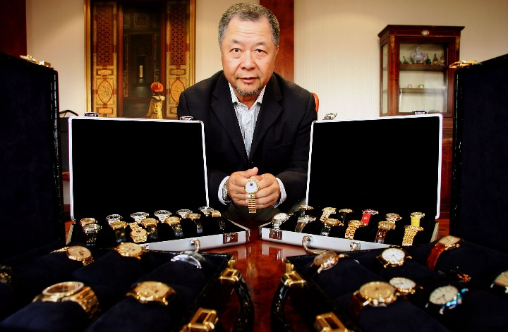
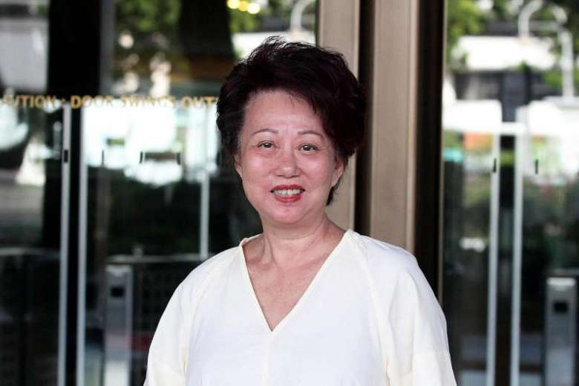
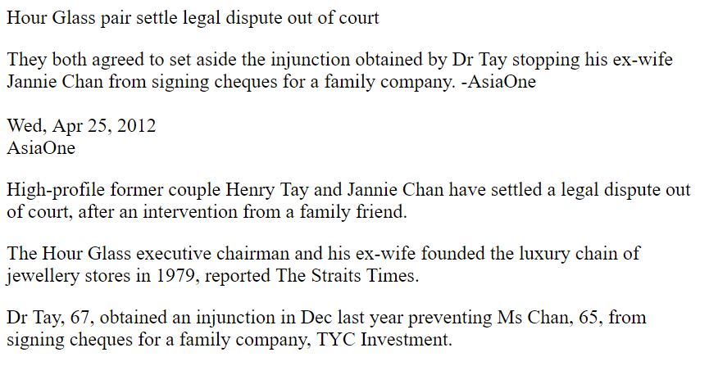
Division of powers between the organs: general principles
TYC Investment Pte Ltd v Tay Yun Chwan Henry [2014] 4 SLR 1149

Slide 29
Division of powers between the organs: general principles
TYC Investment Pte Ltd v Tay Yun Chwan Henry [2014] 4 SLR 1149
Facts: Henry Tay (“HT”) and Jannie Chan (“JC”) were the two directors and shareholders (HT held 46% and JC held 44%) of the first plaintiff company, TYC. Pursuant to divorcement proceedings, a deed between HT and JC provided that “neither HT nor JC will sign a cheque on TYC’s bank accounts unless the other has signed a voucher approving”. Further, the constitution of TYC provided that HT and JC were “Governing Directors” who (1) could not be removed, (2) could jointly restrict the powers of any director and (3) also jointly determine the appointment/dismissal of any director. Subsequently, JC refused to approve a number of payments by TYC to other creditors. HT called an extraordinary general meeting (“EGM”) to address this. There, the resolutions at the EGM granted HT the authority to appoint solicitors to act for TYC and commence court proceedings against JC, and for HT to unilaterally sign cheques on behalf of TYC. Three payments (to other 3P creditors) were in dispute and HT commenced proceedings to seek a declaration that the payments were valid notwithstanding the absence of JC’s approval. JC argued that she was not obliged to approve the three payments as the EGM did not have the power to authorize HT to commence the proceedings. HT also alleged that JC had breached her directors’ duties to the company.

Slide 30
Division of powers between the organs: general principles
TYC Investment Pte Ltd v Tay Yun Chwan Henry [2014] 4 SLR 1149
Held [on the division of powers between corporate organs]: Interpreted Credit Development as authority that the members in general meeting can control the board of directors by passing an ordinary resolution, provided that the resolution is not inconsistent with the Companies Act or the articles of the company (at [81] to [85])
At [86]: “There is a further (open) question as to whether it was also Parliament’s intention that only the board of directors should ever make management decisions… To put this differently, should an express term in a company’s articles conferring management powers upon the shareholders be deemed invalid as a matter of law? Or does s 157A establish a default rule which may be varied by the company’s articles?”

Slide 31
Division of powers between the organs: general principles
TYC Investment Pte Ltd v Tay Yun Chwan Henry [2014] 4 SLR 1149
At [87]: “… I would parenthetically observe that the latter interpretation is preferable because:
[87] (continued): “(a) As a matter of practicality and commercial reality, corporate structures are so varied that it would be impossible to prescribe a set form of corporate governance. For example, there may be good commercial justifications for certain management powers to be reserved to the members in the case of a closely held joint venture company. (b) Under s 157A(2), the directors may exercise all the powers of the company, apart from what the Companies Act or the company’s constitution reserves for the general meeting. (c) Section 198A of the Australian Corporations Act, upon which s 157A is based, is modelled as a “replaceable rule” and therefore can be overridden by express provision in a company’s constitution.”

Slide 32
Division of powers between the organs: general principles
TYC Investment Pte Ltd v Tay Yun Chwan Henry [2014] 4 SLR 1149
At [87] (continued): “(d) The fact that the language of s 157A is replicated in Art 73 of the Table A Articles suggests that a company may choose to depart from the statutorily prescribed division of powers in its constitution. (e) There is nothing in the relevant secondary material which suggests that Parliament had intended s 157A to have the effect of invalidating any attempt to depart from the division of powers under s 157A. (f) Conversely, it would appear that s 157A was intended to prevent shareholders from interfering with the exercise of management powers where these are vested in the board of directors by the constitution. (g) The leading textbook on company law in Singapore supports the view that s 157A establishes a default rule which may be varied by the company’s articles: see Walter Woon on Company Law (Tan Cheng Han gen ed) (Sweet & Maxwell, Revised 3rd Ed, 2009) (“Walter Woon”) at p 150.”
At [88]: “It is therefore my view that the division of powers between the board of directors and the shareholders is a matter of contract under current Singapore law, subject to any provision in the Companies Act.”

Slide 33
Division of powers between the organs: general principles
After TYC Investment, we have strong dicta suggesting that an express term in the company’s articles conferring management powers upon the shareholders will not be deemed invalid as a result of s 157A.
Tjio et.al (pp. 285): position probably inconsequential in small companies where there is a complete overlap between the membership and management of the company, but questions arise in larger companies.

Slide 34
Division of powers between the organs: RESERVE POWERS
The next question arises as to whether the general meeting has a reserve power to act when the board is unable or unwilling to do so itself.
In the absence of such a reserve power, and where the constitution specifies a particular allocation of powers to the respective organs (under both the common law position and the position under s 157A), the shareholders cannot directly intervene where the directors refuse to act.
They could amend the constitution, but this requires a special majority (s 25(1) and s 184(1) CA)
They could remove the directors (via ordinary resolution), but this mandatory rule only applies in the case of public companies (s 152(1) CA)
Commonly referred to as a position of “gridlock”.

Slide 35
Division of powers between the organs: RESERVE POWERS
Barron v Potter [1914] 1 Ch 895
Facts: The company's articles gave the board the power to appoint additional directors to the board. There were 2 directors, B and P. B was not on speaking terms with P and refused to attend meetings. P met B at the train station and despite B's objections, he purportedly held a meeting there and used his casting vote as the chairman of the company to appoint additional directors. At a general meeting called by B, other directors were appointed.
Held: While the alleged board meeting at the train platform was not valid, the general meeting was effective.
The shareholders have reserve powers where there is no competent board (e.g. deadlock or inquorate board).
Per Warrington J: “For practical purposes there is no board of directors at all… There must be some power in the company to do itself that which under other circumstances would be otherwise done”.

Slide 36
Division of powers between the organs: RESERVE POWERS
If Barron v Potter is good law, then shareholders have a residual power to act once there is no competent board.
This is difficult to reconcile in principle with a strict theory of a division of powers (see TYC Investment at [102], Davies and Worthington, 2016 and Grantham, 2004).
Contrast the position in Barron v Potter with the position adopted in Massey v Wales (2003) 47 ACSR 1.

Slide 37
Division of powers between the organs: RESERVE POWERS
Massey v Wales (2003) 47 ACSR 1
Facts: Barel and Rajwan were the two directors of a company, ZH. Barel owned 34% of the company, while Rajwan owned 33%. Rajwan’s brother owned the remaining shares (33%). The relationship between the Rajwans and Barel deteriorated. Subsequently, the two Rajwans commenced proceedings on ZH’s behalf against Barel. Although they did not have authority to do so (this issue was litigated in court), a general meeting of ZH later passed a resolution purporting to ratify the commencement of proceedings.

Slide 38
Division of powers between the organs: RESERVE POWERS
Massey v Wales (2003) 47 ACSR 1
Held: The general meeting had no power to do so (commence litigation proceedings), as general management power had been vested in the board by the company’s constitution.
While the issue of the existence of the GM’s reserve power was a matter of implication from the constitution, where there was an express or general power vested in the general meeting to remove and appoint additional directors, the implication of such reserve power would be generally displaced (see Slide 35).
In this case, since the deadlock would be broken by the general meeting appointing additional directors, it was unnecessary to imply any reserve power to ratify the commencement of legal proceedings.

Slide 39
Division of powers between the organs: RESERVE POWERS
What is the position in Singapore?
Tjio et al (see pp. 288): PK opines that s 157A may not confer management powers on the general meeting, and as such the general meeting has no residual powers, but only powers expressly reserved by the constitution (as per s 157A(2)) or by the Companies Act.
Note: this is inconsistent with the position in Barron v Potter.
However, the cases of TYC Investment Pte Ltd v Tay Yun Chwan Henry [2014] 4 SLR 1149 and Chan Siew Lee v TYC Investments Pte Ltd [2015] 5 SLR 409 suggest that there exists a doctrine of (shareholder) reserve powers in Singapore.
However, the scope of these residual powers is narrow.
These powers arise by way of implied terms, the basis being necessity.

Slide 40
Division of powers between the organs: RESERVE POWERS
TYC Investment Pte Ltd v Tay Yun Chwan Henry [2014] 4 SLR 1149
Held [on the existence of the GM’s reserve powers]: At [104]: “Another view is that reserve powers are a matter of implication under a company’s constitution on the basis of necessity or business efficacy: see for example Ford’s Principles of Corporations Law vol 1 (Butterworths, Looseleaf Ed, 1995) at para 7.130.6. As noted earlier, Massey accepted this as the basis for the qualification to the general rule that powers of management reside in the board alone. In my view, this analysis is persuasive.”
At [105]: “As a matter of principle, the predicate of the compact between the shareholders and the company under s 157A of the Companies Act (and Art 73 of the Table A Articles) is the subsistence of a board of directors that is both competent and willing to manage the affairs of the company. If this predicate is absent or otherwise incapable of fulfilling its purpose, it does not make sense that the company should be powerless to act simply because of the general rule that powers of management are ordinarily exercisable by the directors alone.”

Slide 41
Division of powers between the organs: RESERVE POWERS
TYC Investment Pte Ltd v Tay Yun Chwan Henry [2014] 4 SLR 1149
Held [on the scope of the GM’s reserve powers]: At [107]: “Yet, it must be emphasised that in so far as shareholder reserve powers are a matter of implication, their scope is narrow and the express terms of the contract between the shareholders and directors should be respected as far as possible. In this regard, I agree with Hodgson JA’s view in Massey that there is no wide doctrine of reserve powers. A wide doctrine of reserve powers can only rest on the proposition that the board is generally subject to the control and direction of the shareholders. As I have already noted, this would be untenable in view of s 157A (and Art 73 of the Table A Articles)”

Slide 42
Division of powers between the organs: RESERVE POWERS
TYC Investment Pte Ltd v Tay Yun Chwan Henry [2014] 4 SLR 1149
Held [on the scope of the GM’s reserve powers]: At [108]: “… the cases on reserve powers can be distilled into the following set of principles: (a) Reserve powers do not devolve to the shareholders unless the board is unable or unwilling to act. (i) In relation to unwillingness, the fact that shareholders disagree with a bona fide board decision will not in itself be sufficient. (ii) However, if the directors who are preventing the company from suing are the wrongdoers themselves, this requirement is more often than not satisfied. (b) If the deadlock in management may be broken in some other way under the company’s constitution (as was the case in Massey), then the court should refuse to recognise that shareholders have reserve powers of management. (i) The reason for this proposition is that reserve powers are implied under a company’s constitution on the basis of necessity. The corollary to this proposition is that mere convenience will not justify the exercise of management powers by shareholders. (ii) In this regard, I note that in Massey, the deadlock in management could have, as a matter of contract, been broken by appointing additional directors…”

Slide 43
Division of powers between the organs: RESERVE POWERS
TYC Investment Pte Ltd v Tay Yun Chwan Henry [2014] 4 SLR 1149
Held [on the scope of the GM’s reserve powers]: At [108]: “…(c) The scope of the reserve powers which the shareholders may exercise would depend on the facts of each case. (i) The cases have not established any general proposition governing the issue of scope. In my view, it is clear that reserve powers may not be exercised to contravene an express term in a company’s articles. (ii) A convenient test, in my view, can be stated as what is reasonably necessary in the circumstances of the case. The reference to necessity recognises that reserve powers arise because of a deadlock in management and hence their scope should ordinarily go no further than what is necessary to break that deadlock. It reinforces the point that reserve powers are narrow in scope. (iii) The reference to reasonableness, on the other hand, recognises the practical difficulties and uncertainties which shareholders face in the purported exercise of reserve powers. Necessity must therefore be judged with a degree of latitude. (d) Keeping in mind that it is all a matter of contract, the resolution in general meeting to commence proceedings must be passed in accordance with the requisite majority as prescribed by the company’s constitution. Absent any super majority requirement contained in the company’s constitution, the power to commence proceedings may be authorised by an ordinary resolution.”

Slide 44
Division of powers between the organs: RESERVE POWERS
TYC Investment Pte Ltd v Tay Yun Chwan Henry [2014] 4 SLR 1149
Applying these principles to the facts of the case, the High Court held that the GM had a reserve power to appoint solicitors not only for the purposes of bringing proceedings with a view to determining the rights and obligations of the parties, but also to commence proceedings against JC for alleged breach of directors duties.
Unlike Massey, the appointment of additional directors could not have broken the deadlock as both the divorce settlement deed and TYC’s constitution required the agreement of both HT and JC.

Slide 45
Division of powers between the organs: RESERVE POWERS
On appeal, the SGCA clarified the law on the residual powers of the GM in Singapore.
Two further cumulative requirements:
First, that the matter in respect of which the general meeting is intervening must relate to "the performance of a bona fide obligation owed by the company to a third party"; and
Secondly, there is nothing to indicate that it would be otherwise than in the company's interests that the obligation is honoured.
That being so, it differed with the SGHC on the application of the law to the facts of the case.
Chan Siew Lee v TYC Investments Pte Ltd [2015] 5 SLR 409 is now reflective of the position re residual powers of the GM in Singapore.

Slide 46
Division of powers between the organs: RESERVE POWERS
Chan Siew Lee v TYC Investments Pte Ltd [2015] 5 SLR 409
Held [on the existence of the GM’s reserve powers]: At [36]: “We agree with the Judge that the analysis of whether there is a reserve power vested in the general meeting is one that must be situated in the context of implied terms. The division of power between the board of directors and the shareholders in a general meeting is a matter of contract, or a “compact” as the Judge put it at [89], [90] and [105] of the GD, which is set out in the company’s constitution. That contract is between the shareholders and the company, and between the shareholders inter se: s 39 of the Companies Act. In general, the court will lean towards preserving this division, not least because it has no power to alter the company’s memorandum or articles, save on limited grounds (eg, under s 216 of the Companies Act); but also because there is no reasonable basis for thinking that management responsibilities should also be allocated to the shareholders, where there is a general provision that they are allocated to the directors. This accords with good commercial sense because the directors are constrained to act in accordance with their fiduciary duties. Shareholders, on the other hand, are not. The preference for vesting management power in the board of directors alone is thus grounded in the fact that the risk of managerial abuses is best curbed by allocating the responsibility to manage the company to the directors, who in turn are constrained by the fiduciary duties they owe to the company.”

Slide 47
Division of powers between the organs: RESERVE POWERS
Chan Siew Lee v TYC Investments Pte Ltd [2015] 5 SLR 409
Held [on the existence of the GM’s reserve powers]: At [37]: “That said, this cannot be an inflexible or unyielding rule – in exceptional circumstances, reserve powers may be implied in favour of the shareholders in general meeting. As with implied terms in general, the basis for doing so is necessity. There are two important corollaries of this. First, management powers are reserved to the shareholders in a general meeting only where the board of directors is deadlocked or is unable or unwilling to act. Second, their scope is limited to what is necessary to resolve the deadlock..”
Incorrect to say that direct management power can never vest in the shareholders (see [39] to [40]).

Slide 48
Division of powers between the organs: RESERVE POWERS
Chan Siew Lee v TYC Investments Pte Ltd [2015] 5 SLR 409
Held [on the scope of reserve powers]: At [45]: “even such a reserve power must be limited and that limitation may be found in two cumulative requirements: (a) the dispute must relate to the performance of a bona fide obligation owed by the company to a third party; and (b) there is no material suggesting that it will not be in the company’s best interest to honour these obligations. These limitations serve to ensure that the power reserved to the general meeting is not to do whatever the board may do and hence, in effect, to step into the shoes of the board. Rather, it is limited to the minimum necessary to keep the company going by enabling it to meet its bona fide obligations as long as it is not shown that the company would be better off not meeting them.”
Courts are balancing the interests of competing factions: between innocent 3P creditors and the disputing parties within the company (see [47]).

Slide 49
Division of powers between the organs: RESERVE POWERS
Chan Siew Lee v TYC Investments Pte Ltd [2015] 5 SLR 409
Held [on the scope of reserve powers]: Reserve powers will not arise where there is either (a) no deadlock; or (b) the deadlock can be broken by the appointment of additional directors and/or the removal of existing directors in a general meeting (see [49]).
Hence, the shareholders cannot use their reserve powers to override/supersede the powers of the board where these conditions exist (see the cases we have considered, such as Automatic Self-Cleaning Filter Syndicate Co v Cunninghame [1906] 2 Ch 34, John Shaw & Sons (Salford) Ltd v Shaw [1935] 2 KB 113, and even Quin & Axtens, Limited v Salmon [1909] AC 442)
There may be no reason to imply terms where the claim can be appropriately resolved by a derivative action commenced under s 216A of the Companies Act (see [54], subsequent topic).

Slide 50
Division of powers between the organs: RESERVE POWERS
Chan Siew Lee v TYC Investments Pte Ltd [2015] 5 SLR 409
Applying these principles to the facts of the case, the SGCA held that the implication of a reserve power to authorise payments was not precluded by or inconsistent with the company’s constitution, as the explicit requirement that both directors agree to any payment (made to 3P creditors) was predicated on the existence of a co-operative board (see [76]).
At [77]: “To put it another way: the Payment Clause could not meaningfully stand in the way of a legitimately authorised liability of the company being met once the shareholders pursuant to and within the limits of a reserve power had determined that it should be met.”
No defence if 3P had sued for payment – best interests of TYC to meet these payments (see [78]).

Slide 51
Division of powers between the organs: RESERVE POWERS
Chan Siew Lee v TYC Investments Pte Ltd [2015] 5 SLR 409
The shareholders had a reserve power to decide whether payments could be made to 3Ps, and so had an ancillary reserve power to appoint solicitors to advise them on this (see [80]).
However, there was no reserve power (of the GM) to commence proceedings against JC, as there was an adequate remedy for JC’s potential conflict of interests under s 216A of the Companies Act (see [84] and [85]).

Slide 52
Q&A
See you guys next class.

Slide 53
bibliography
Deck 10 Slide 10: C.f. Berle and Means (1932), who thought that vesting power in the shareholders would ameliorate managerial-shareholder agency costs. Is from “The Modern Corporation and Private Property”, Adolf Berle and Gardiner Means, (Transaction Publishers, 1932) at 110-111.
C.f. Blair and Stout (1999). Vesting authority/power in the board of directors ameliorates the incentives for shareholders to “use their power of ownership against each other” is from Blair, Margaret M. and Stout, Lynn A., “A Team Production Theory of Corporate Law”. Available at SSRN: https://ssrn.com/abstract=425500 or http://dx.doi.org/10.2139/ssrn.425500 at 274, footnote 56.
Deck 10 Slide 13: Benefits from separation of ownership and control + the credible delegation of authority to managers (see Alonso and Matouschek 2007) is from “Relational delegation”, Ricardo Alonso and Niko Matouschek. RAND Journal of Economics, 2007, vol. 38, issue 4, 1070-1089 at 1077-1079.
Deck 10 Slide 25: CLRFC Report 2002 is from “REPORT OF THE COMPANY LEGISLATION AND REGULATORY FRAMEWORK COMMITTEE” (OCTOBER 2002) SINGAPORE. Available at: http://www.commonlii.org/sg/other/SGLRC/report/R14/14.html.
Deck 10 Slide 26: See also Koh (2004) is from Koh, Pearlie. 2004. "Business organisations." In Basic Principles of Singapore Business Law, edited by Andrew Phang, 477-498. Singapore: Thomson Learning.

